Slide 1


Algorithms Design and Analysis
算法设计与分析
山东大学软件学院 2023

Slide 2
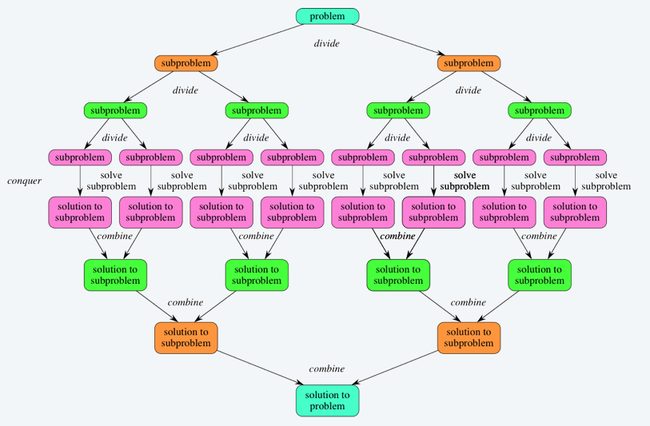
Chapter 4 Divide-and-Conquer
Divide-and-conquer
Divide up problem into several sub-problems (of the same kind).
Solve (conquer) each subproblem recursively.
Combine solutions to subproblems into overall solution.

Slide 3
Chapter 4 Divide-and-Conquer
Divide-and-conquer
当子问题足够大以进行递归求解时，称其为递归情况（recursive case）
一旦子问题变得很小，以至不再需要递归的程度，就说递归“结束（bottom out）”了，已经回到了基本情况（base case）
Recursive in structure
Problem(size n)
sub
problem 1
sub
problem 2
…
sub
problem k
Combine
sub
problem 11
sub
problem 12
…
sub
problem 1k
sub
problem 21
sub
problem 22
…
sub
problem 1k
…
………………………
………………
sub
problem 1’
sub
problem 2’
sub
problem 3’
………………
directly solvable

Slide 4
递归式（recurrence）
递归式（recurrence）是一组等式或不等式，其描述的函数是用在更小的输入下该函数的值来定义的。
介绍三种解递归式的方法，即找出解的渐近 Θ 或 O 界的方法。
代换法（substitution method）：先猜测一个界，再使用数学归纳法证明猜测的正确性。
递归树方法（recursion-tree method）：将递归式转化为树，树中的结点代表不同递归层次付出的代价。使用边界求和的技巧来解递归。
主方法（master method）：给出递归形式 T(n) = aT(n/b) + f(n) 的界，其中 a ≥ 1 ，b > 1 ，f(n) 是给定的函数。

Slide 5
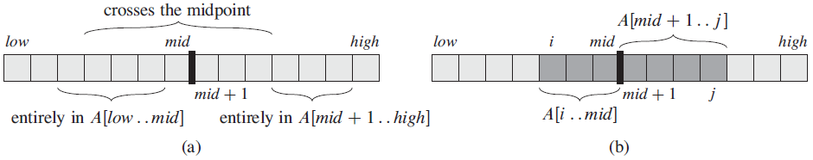
最大子数组问题（The maximum-subarray problem）
Problem: You are allowed to buy one unit of stock only one time and then sell it at a later date. Your goal is to maximize your profit.
问题：允许购买一次股票，然后在以后的某个日期将其出售，目标是使利润最大化。
Day | 0 | 1 | 2 | 3 | 4 | 5 | 6 | 7 | 8 | 9 | 10 | 11 | 12 | 13 | 14 | 15 | 16
Price | 100 | 113 | 110 | 85 | 105 | 102 | 86 | 63 | 81 | 101 | 94 | 106 | 101 | 79 | 94 | 90 | 97
Change |  | 13 | -3 | -25 | 20 | -3 | -16 | -23 | 18 | 20 | -7 | 12 | -5 | -12 | -5 | -4 | 7
暴力解决方案（A brute-force solution）
尝试所有可能的购买和出售日期对，购买日期要早于出售日期。n 天的时间段有C_{n}²个这样的日期对。 C_{n}² =Θ(n²)，这种方法将花费 Ω(n²) 时间。
分而治之算法（A divide-and-conquer solution）

Slide 6
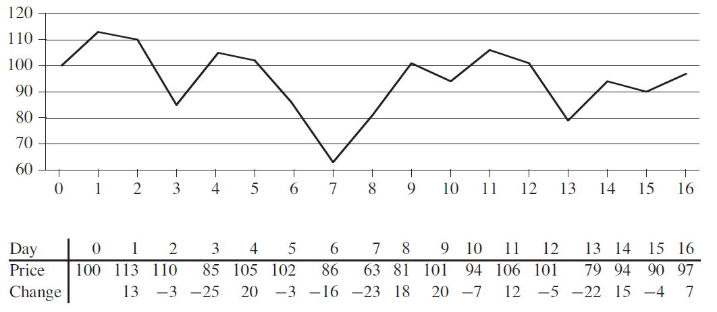
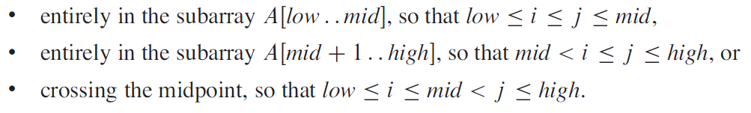
最大子数组问题（The maximum-subarray problem）

Slide 7
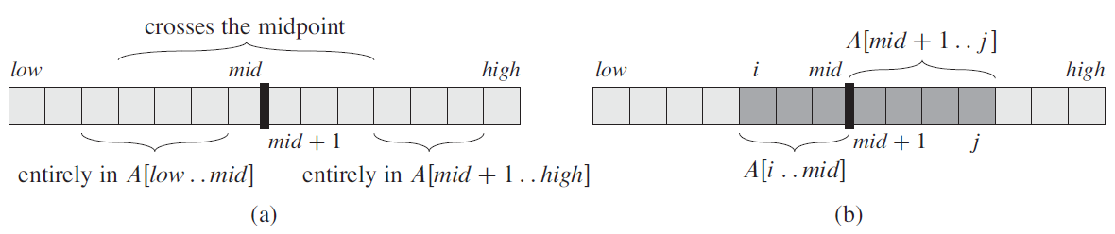
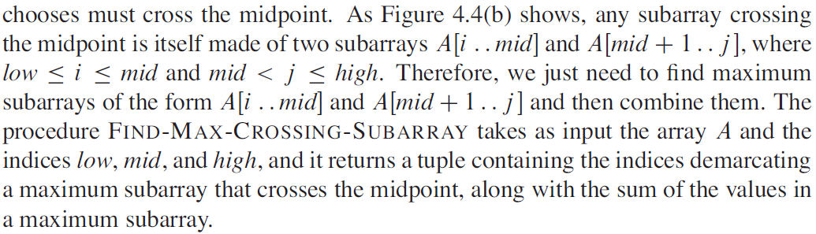
最大子数组问题（The maximum-subarray problem）

Slide 8
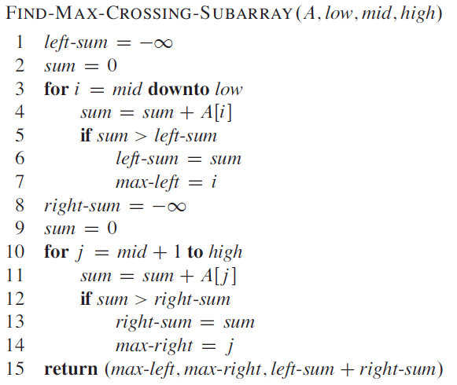
A solution using divide-and-conquer
程序 FIND-MAX-CROSSING-SUBARRAY 找出子数组 A[low..high]，A[low..high] 中跨越中点（称为 mid）的最大子数组，运行时间可表示为 Θ(n)，其中n是子数组 A[low..high] 的元素个数。

Slide 9
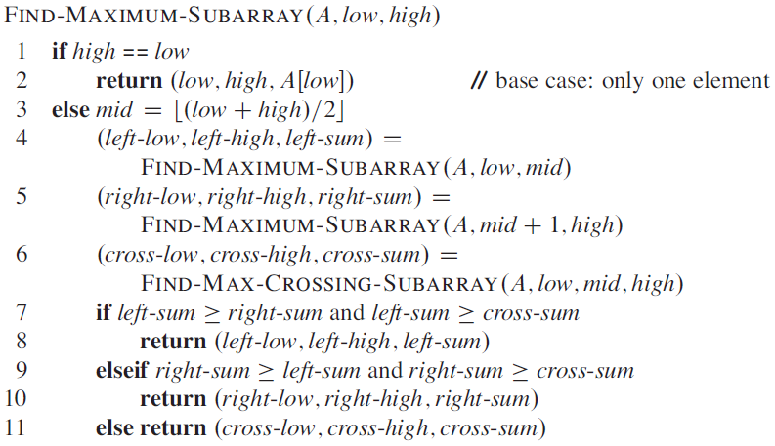
A solution using divide-and-conquer
With a linear-time FIND-MAX-CROSSING-SUBARRAY procedure in hand, we can write pseudocode for a divide-and-conquer algorithm to solve the maximum-subarray problem:

Slide 10
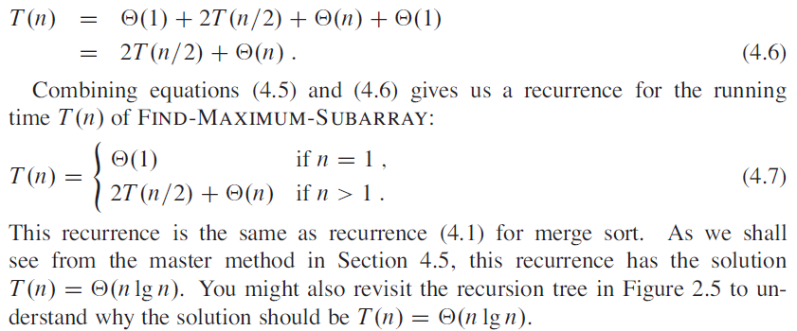
Analyzing the divide-and-conquer algorithm
Exercise 4.1-5：（作业1）
there is in fact a linear-time algorithm for the maximum-subarray problem, and it does not use divide-and-conquer.

Slide 11
Strassen’s algorithm for matrix multiplication

Slide 12
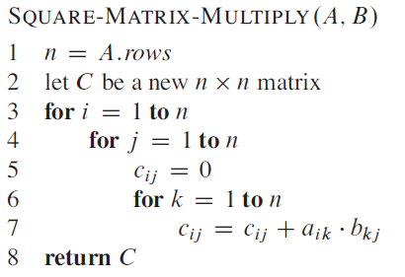
SQUARE-MATRIX-MULTIPLY procedure

Slide 13
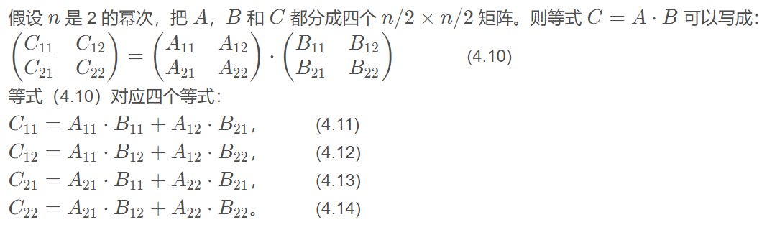
A simple divide-and-conquer algorithm

Slide 14
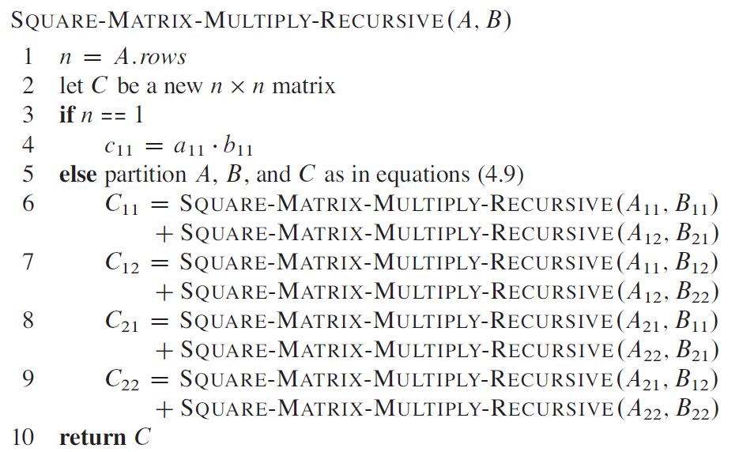
A simple divide-and-conquer algorithm

Slide 15
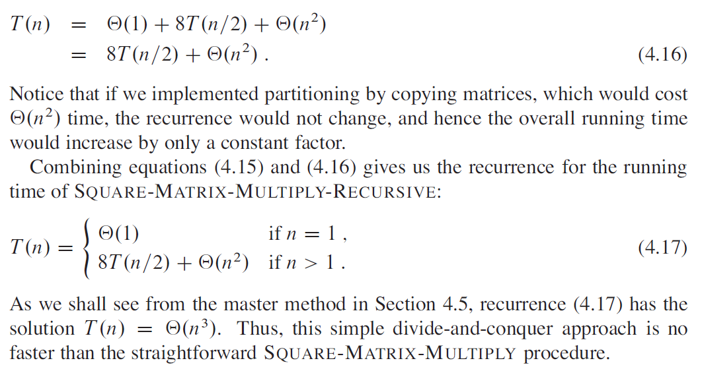
A simple divide-and-conquer algorithm

Slide 16
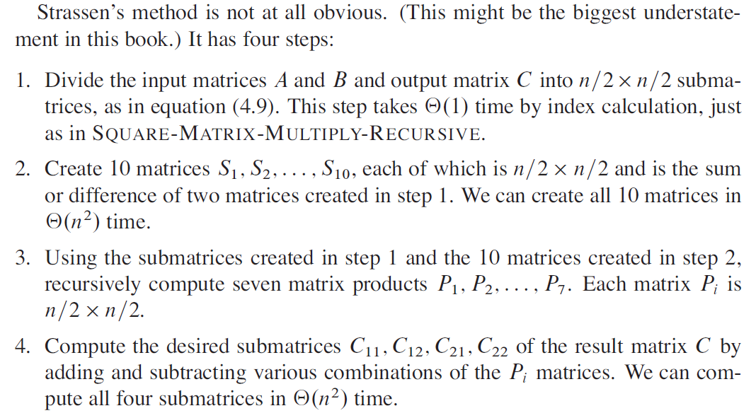
Strassen’s method

Slide 17
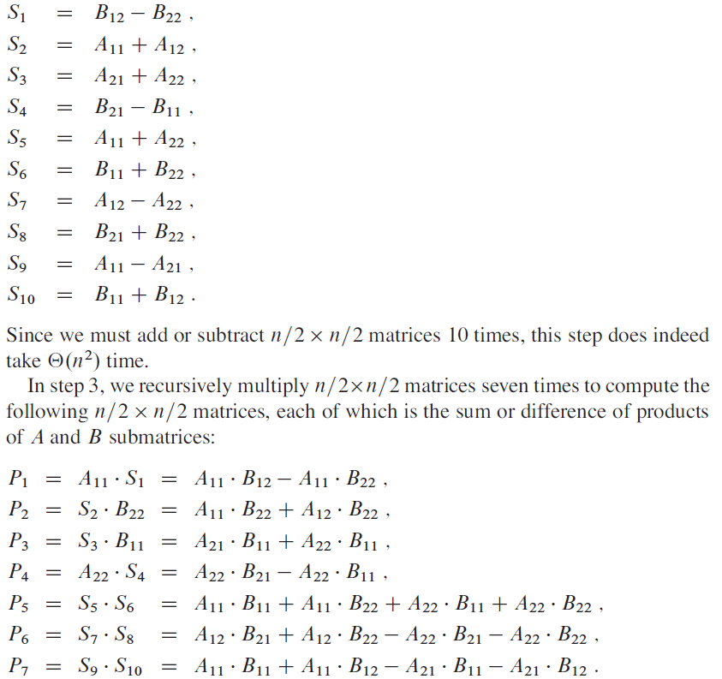
Strassen’s method
C₁₁=P₅+P₄-P₂+P₆
C₁₂=P₁+P₂
C₂₁=P₃+P₄
C₂₂=P₅+P₁-P₃-P₇

Slide 18
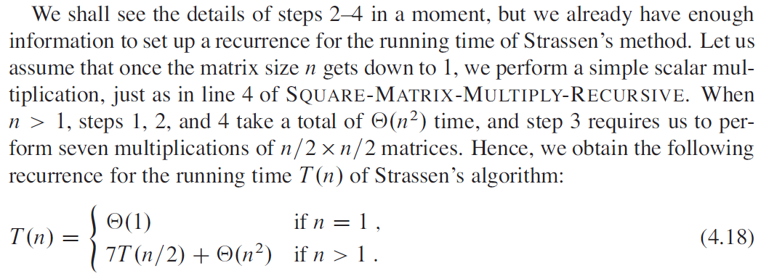
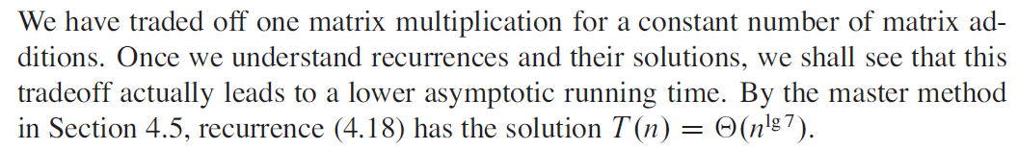
Strassen’s method

Slide 19
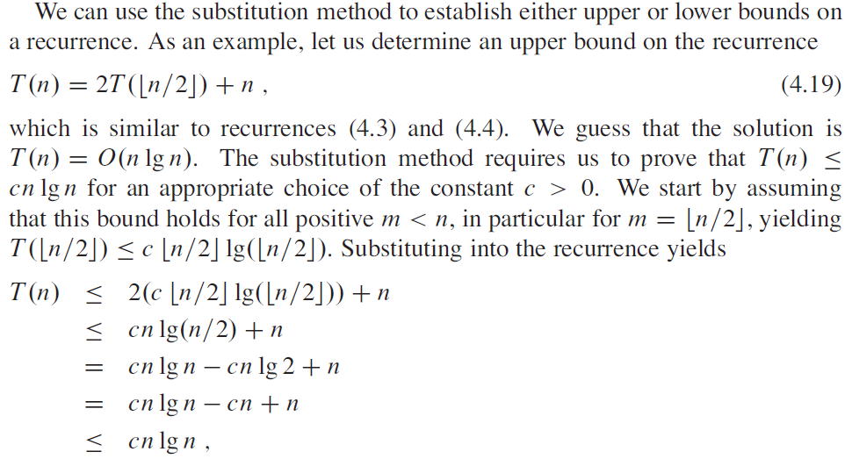
4.3 The substitution method for solving recurrences
The most general method:
-- Guess the form of the solution
-- Verify by induction
-- Solve for constants

Slide 20
The substitution method for solving recurrences
Ex. T(n) = 4T(n/2) + 100n
-- Assume that T(1) = Θ(1)
-- Guess O(n³). (Prove O and Ω separately for Θ.)
-- Assume that T(k) ≤ck³ for k < n
-- Prove T(n) ≤cn³ by induction
T(n) = 4T(n/2) + 100n
≤4c(n/2)³ + 100n
= (c/2)n³ + 100n
= cn³ – ((c/2)n³ – 100n)
≤cn³
desired-residual
desired
Whenever (c/2)n³ – 100n ≥ 0, for example, if c ≥ 200 and n ≥ 1
residual
Make a good guess：Exercises 4.3-8 (作业2）

Slide 21
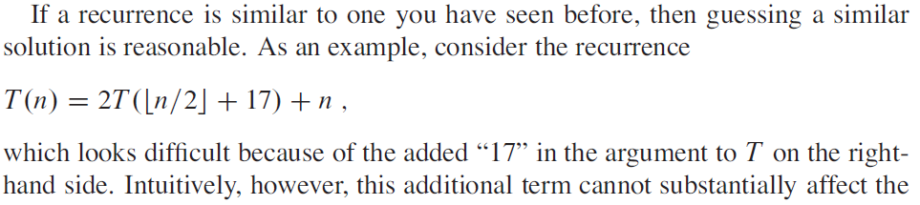
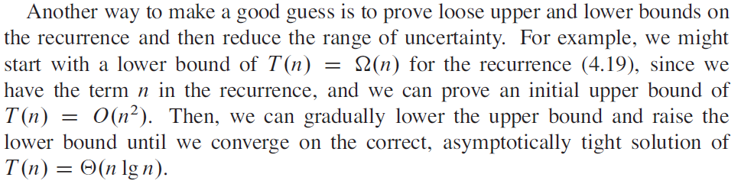
Make a good guess

Slide 22
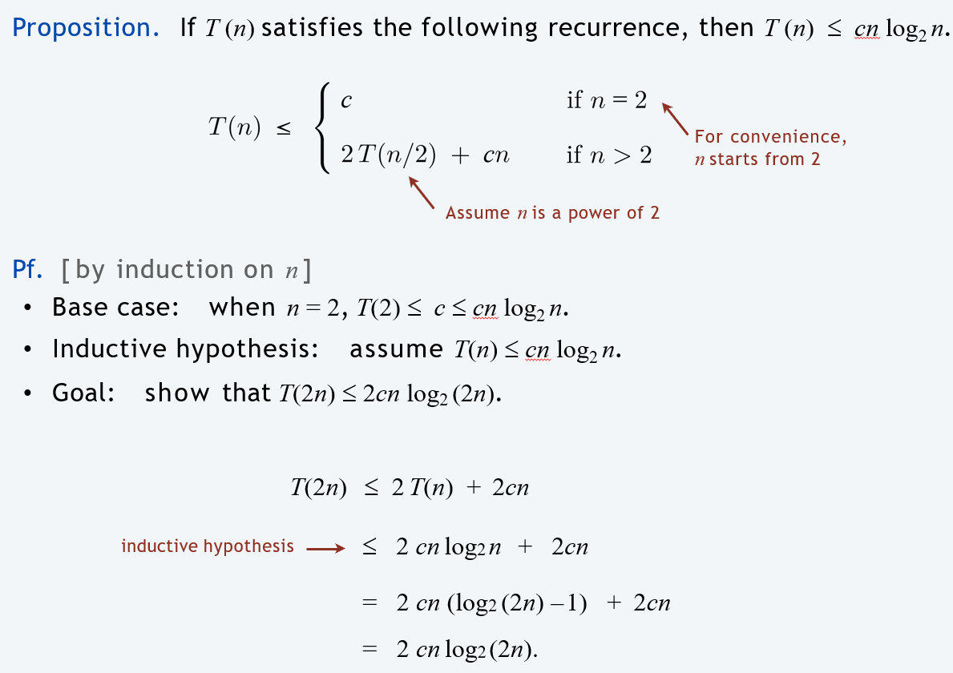
Avoiding Pitfalls
Be careful not to misuse asymptotic notation. For example:
-- We can falsely prove T(n) = O(n) by guessing T(n) ≤cn for T(n) = 2T( ) + n
T(n) ≤ 2c + n
≤ cn + n
= O(n)
Wrong
-- The error is that we haven’t proved the exact form of the inductive hypothesis T(n) ≤ cn.

Slide 23
Changing Variables
Use algebraic manipulation to make an unknown recurrence similar to what you have seen before.
-- Consider T(n) = 2T( ) + lgn,
-- Rename m = lgn and we have
T(2^{m}) = 2T(2^{m/2}) + m.
-- Set S(m) = T(2^{m}) and we have
S(m) = 2S(m/2) + m → S(m) = O(mlgm)
-- Changing back from S(m) to T(n), we have
T(n) = T(2^{m}) = S(m) = O(mlgm) = O(lgnlglgn)

Slide 24
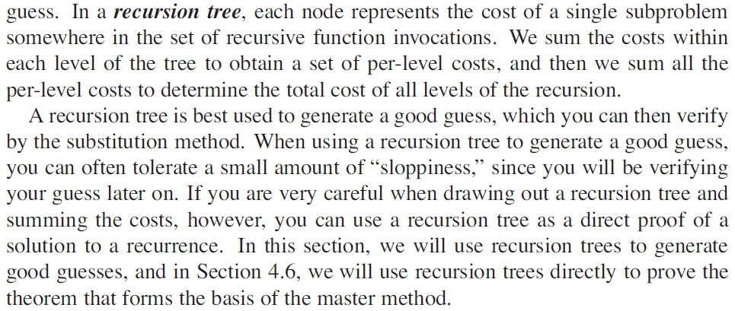
4.4 Recursion - tree method
A recursion tree models the costs (time) of a recursive execution of an algorithm.
The recursion tree method is good for generating guesses for the substitution method.
the recursion-tree method can be unreliable, just like any method that uses ellipsis (…).
The recursion-tree method promotes intuition, however.

Slide 25

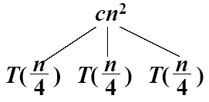
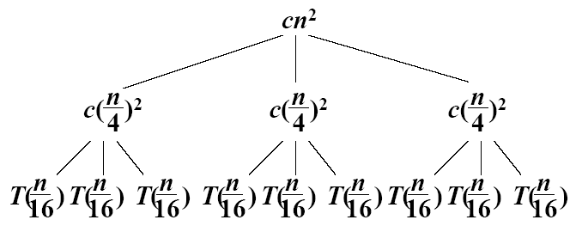
The Construction of a Recursion Tree
Solve T(n) = 3T(n/4) + Θ(n²), we have

Slide 26
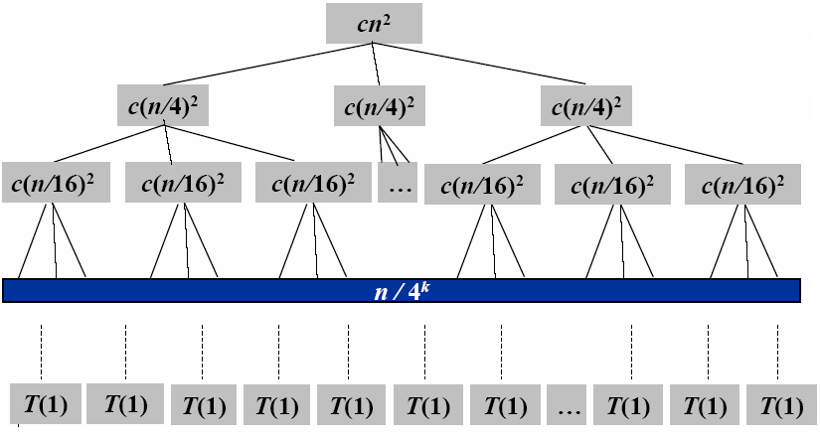
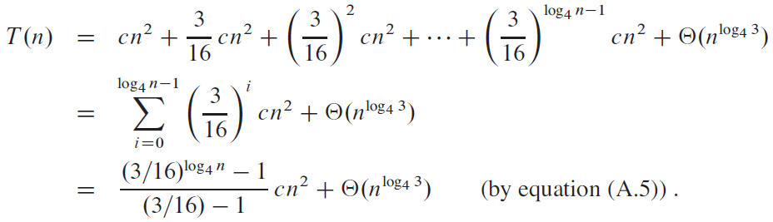
Construction of Recursion Tree
cn²
log₄n+1
Geometric series
Total: O(n²)
The fully expanded tree has lg₄n+1 levels, i.e., it has height lg₄n

Slide 27
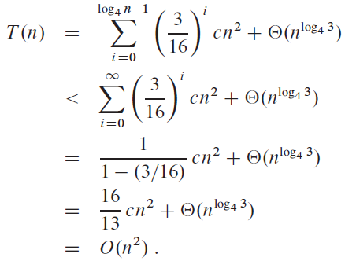
Construction of Recursion Tree
cn²
log₄n+1
Geometric series
Total: O(n²)

Slide 28
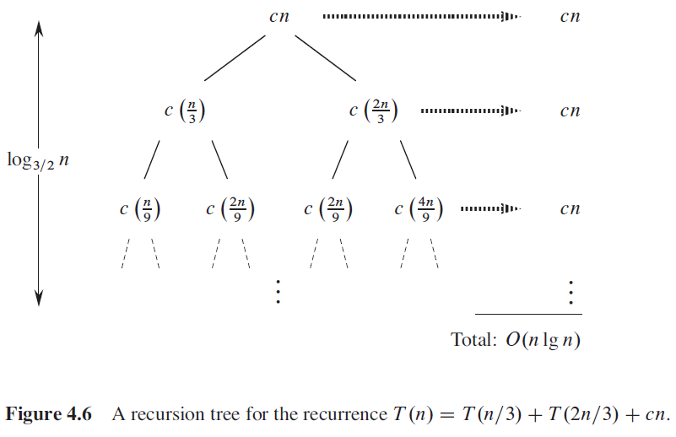
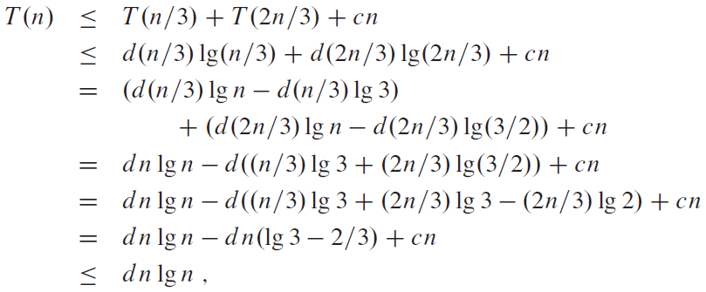
Construction of Recursion Tree

Slide 29

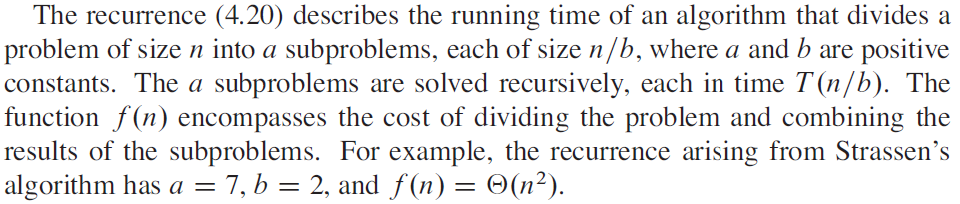
4.5 Master Method
It provides a “cookbook” method for solving recurrences of the form:
T(n) = a T(n/b) + f(n)
Where a ≥ 1 and b > 1 are constants and f(n) is an asymptotically positive function.

Slide 30
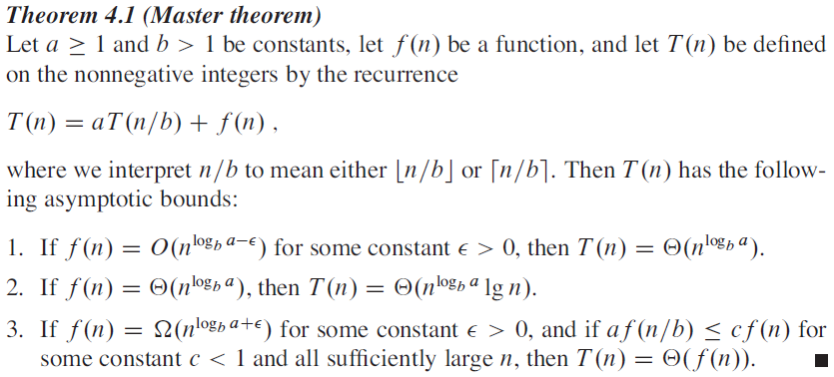
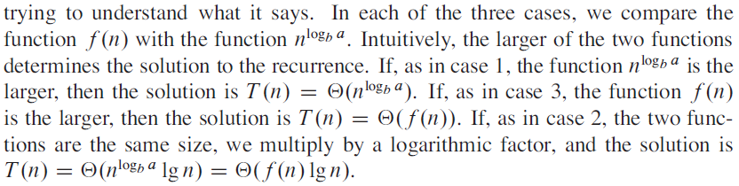
The master theorem

Slide 31
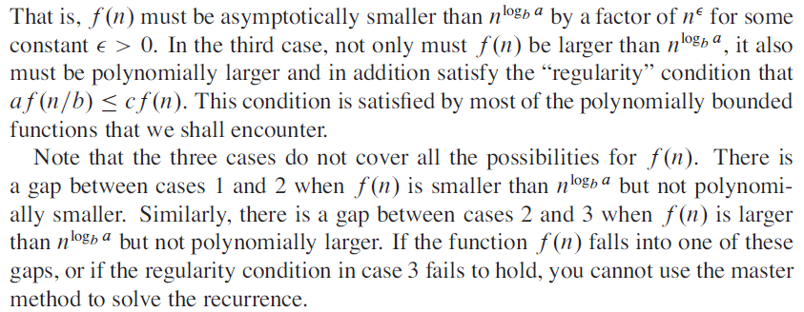
The master theorem

Slide 32

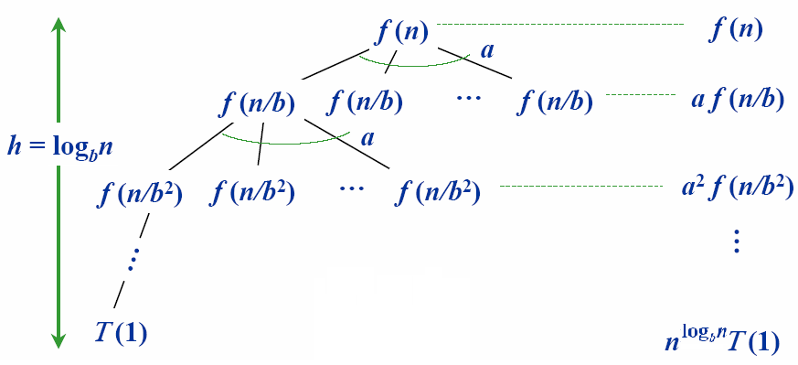
Idea of master theorem
Recursion tree
a
#leaves = a^{h}
= a^{logbn}
= n^{logba}

Slide 33
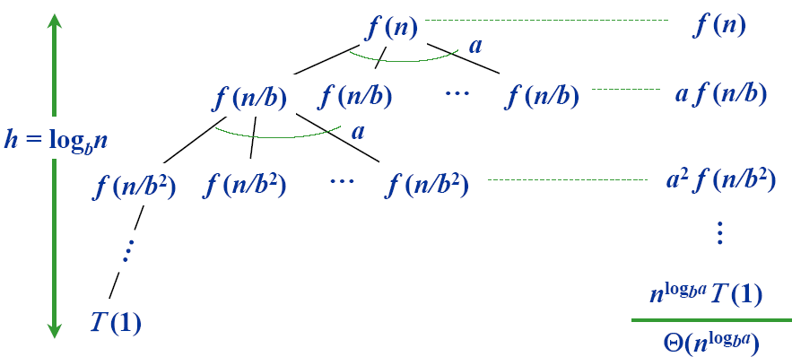
Three common cases
Compare f(n) with n^{logba} :
-- 1. f(n) = O(n^{logba-ε}) for some constantε> 0
>> f(n) grows polynomially slower than n^{logba} (by an n^{ε} factor),
-- Solution: T(n) = Θ(n^{logba})
Recursion tree
CASE 1: The weight increases geometrically from the root to the leaves. The leaves hold a constant fraction of the total weight.

Slide 34
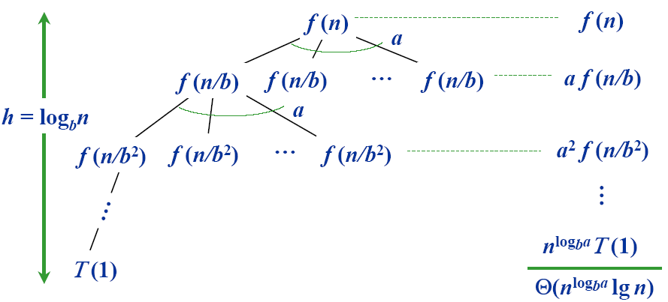
Three common cases
Compare f(n) with n^{logba} :
-- 2. f(n) = Θ(n^{logba}) for some constant k≥ 0
>> f(n) and n^{logba} grow at similar rates,
-- Solution: T(n) = Θ(n^{logba}log_{b}n)
Recursion tree
CASE 2: (k = 0) The weight is approximately the same on each of the log_{b}n levels.

Slide 35
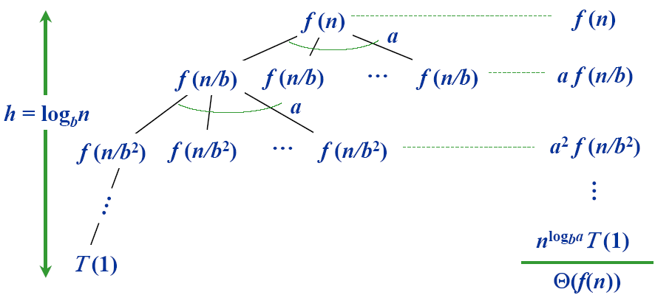
Three common cases
Compare f(n) with n^{logba} :
-- 3. f(n) = Ω(n^{logba+ε}) for some constantε> 0
>> f(n) grows polynomially faster than n^{logba} (by an n^{ε} factor),
-- and f(n) satisfies the regularity condition that af(n/b) ≤cf(n) for some constant c < 1
-- Solution: T(n) = Θ(f(n))
Recursion tree
CASE 3: The weight decreases geometrically from the root to the leaves. The root holds a constant fraction of the total weight.

Slide 36
Three common cases
Compare f(n) with n^{logba} :
1. f(n) = O(n^{logba -ε}) for some constant ε> 0
f(n) grows polynomially slower than n^{logba} (by an n^{ε} factor),
Solution: T(n) = Θ(n^{logba})
2. f(n) = Θ(n^{logba}) for some constant k≥ 0
f(n) and n^{logba} grow at similar rates,
Solution: T(n) = Θ(n^{logba}log_{b}n)
3. f(n) = Ω((n^{logba+ε}) for some constant ε> 0
f(n) grows polynomially faster than n^{logba} (by an n^{ε} factor),
and f(n) satisfies the regularity condition that af(n/b) ≤cf(n) for some constant c < 1
Solution: T(n) = Θ(f(n))

Slide 37
Master theorem - examples
T(n)=9T(n/3)+n
a=9, b=3, f(n) = n
log_{b}a = 2, f(n) = O(n^{log}bª ^{–ε}) where ε=1, case 1
T(n) = Θ(n^{log}bª) =Θ(n²)
T(n)=T(2n/3)+1
a=1, b=3/2, f(n) = 1
log_{b}a = 0, f(n) = Θ(n^{log}bª), case 2
T(n) = Θ(n^{log}bªlgn) =Θ(lgn)
T(n)=3T(n/4)+nlgn
a=3, b=4, f(n) = nlgn
log_{b}a = log₄3≈0.793, f(n) = Ω(n^{log}bª ^{+ε}) where ε≈ 0.2
af(n/b) = 3f(n/4) = 3(n/4)lg(n/4)≤(3/4)nlgn = cf(n) where c = 3/4, case 3
T(n) = Θ(f(n)) =Θ(nlgn)

